Slide 1


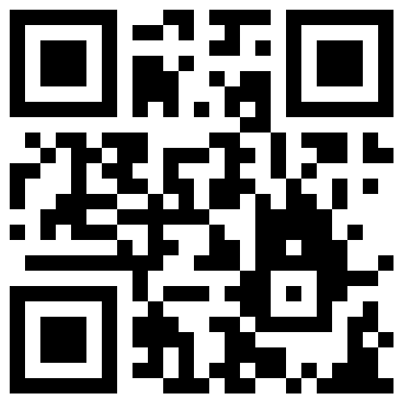
Peak ETL
TRANSFORMING DATA INTO ENERGY MARKET INSIGHTS
Jason Holden
www.peaketl.com
CEO, PRESENTOR
JASON@PEAKETL.COM | (918) 409-CODE (2633) | (719) 200-9872

Slide 2

About Me Professional developer for more than 25 years
Our Story (so far):
I started working with computers at the age of 13. Growing up in a small town in eastern Oklahoma, I acquired a reputation as the “computer kid.” I started my professional career programming applications using Visual FoxPro. Over the last twenty-five years, I’ve used numerous other languages and platforms to develop countless database applications and services. My newest endeavor is Peak ETL. We’re creating a subscription-based platform to aggregate and analyze public oil and gas data and deliver it to industry professionals for use in their operations.
Jason Holden
CEO & Founder

Slide 3

Open-source
Development.
Why Open-source?
Cost
Cost: Tools like Docker, Flask, and PostgreSQL reduce licensing costs compared to commercial solutions like Microsoft SQL Server or Azure.
Flexibility: Provides unparalleled flexibility, allowing developers to modify source code, integrate diverse technologies, and deploy applications across various platforms without vendor lock-in.
Community: Active and talented communities contribute to rapid development, troubleshooting, and feature enhancements.
Transparency: Community members can review and audit the system for security vulnerabilities.
Everywhere: Open source is everywhere, from tech giants (including Microsoft) to little startups (like Peak ETL).
Reduce licensing costs compared to commercial solutions.
Advancement
Open-source projects advance faster
Customizable
Modify for specific business needs.

Slide 4










Our
Stack.
The Best of Both Worlds
Code: C#, Java, Python, and JavaScript
Database: Postgres, Microsoft SQL, and MongoDB
Source control: Github.com
OS: Linux and Windows

Slide 5
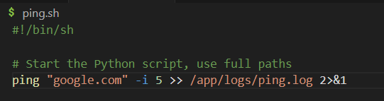
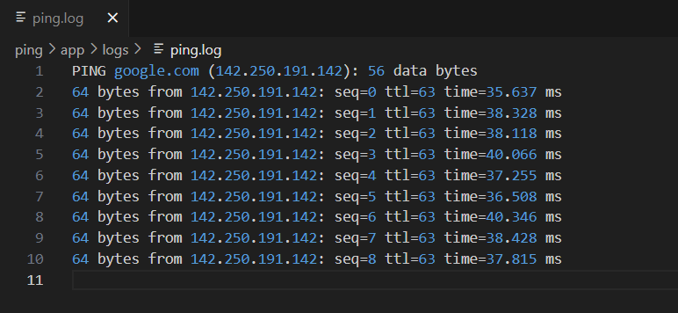
Demo
PING
PING a remote server
Code: Bash script to execute PING and log to a file
Container: /app folder mapping for viewing log files from the container host

Slide 6
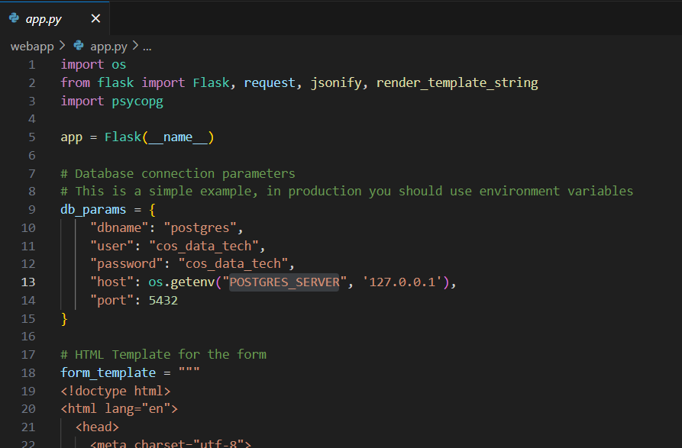
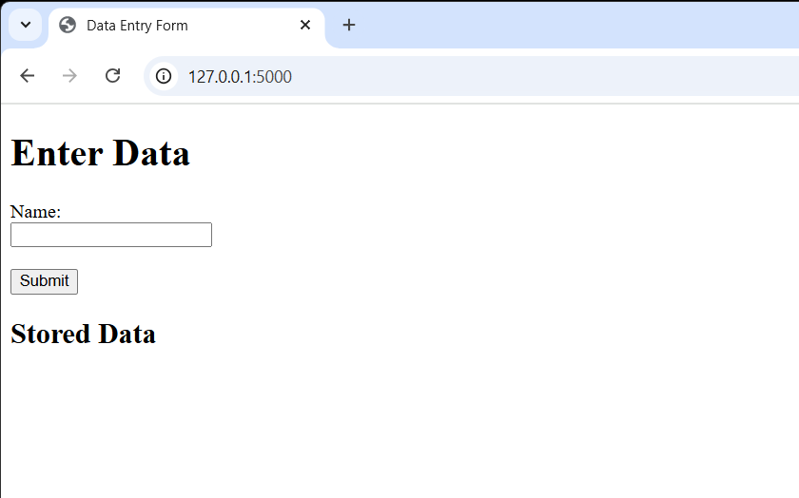
Demo
Web Application
Flask Web Application
Code: app.py Flask application with single data entry form
Containers: Application container (Python) and database container (Postgres)

Slide 7
Key
Take Aways
Open-source is the Future
Development: Open-source can jump-start your development.
Not mutually exclusive: You can have the best of both words.
Future proof: The leading AI toolsets are built on open-source technology.

Slide 8

Contact
Us.
CONTACT
(719) 200-9872 (918) 409-2633
www.peaketl.com
jason@peaketl.com

